Slide 1
S2-19_DSECLZC415 Classification and Prediction
Presented by Dr.D.VENAKTA SUBRAMANIAN
23rd May 2020
Slide Courtesy: Prof. T.V. Rao

Slide 2

The slides presented here are obtained from the authors of the books and from various other contributors. I hereby acknowledge all the contributors for their material and inputs.
I have added and modified a few slides to suit the requirements of the course.

Slide 3
Classification

Slide 4
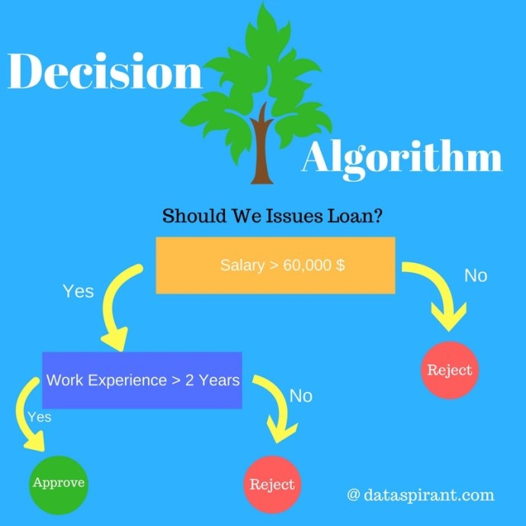

Slide 5
Decision Tree – Basic Introduction
Decision Tree algorithm belongs to the family of supervised learning algorithms.
Unlike other supervised learning algorithms, decision tree algorithm can be used for solving regression and classification problems too.
The general motive of using Decision Tree is to create a training model which can use to predict class or value of target variables by learning decision rules inferred from prior data(training data).
The decision tree algorithm tries to solve the problem, by using tree representation.
Each internal node of the tree corresponds to an attribute, and each leaf
node corresponds to a class label.
Decision Tree Algorithm Pseudocode
(1). Place the best attribute of the dataset at the root of the tree.
(2). Split the training set into subsets. Subsets should be made in such a way that each subset contains data with the same value for an attribute.
(3). Repeat step 1 and step 2 on each subset until you find leaf nodes in all the branches of the tree.

Slide 6
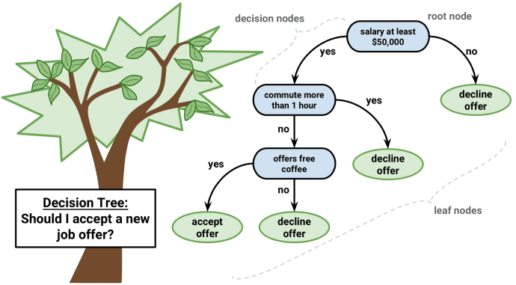

Slide 7
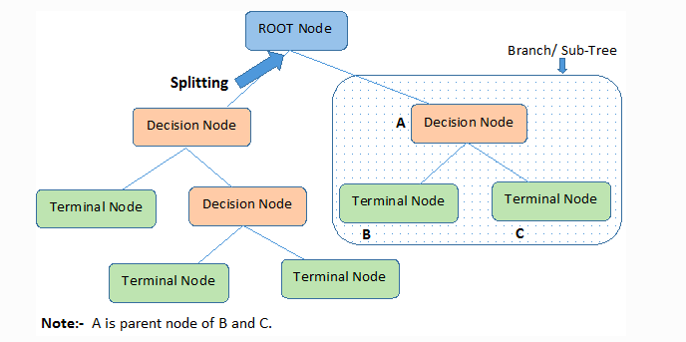
Important terminologies in decision tree
Root Node: It represents the entire population or sample and this further gets divided into two or more homogeneous sets.
Splitting: It is a process of dividing a node into two or more sub-nodes.
Decision Node: When a sub-node splits into further sub-nodes, then it is called the decision node.
Leaf / Terminal Node: Nodes do not split is called Leaf or Terminal node.
Pruning: When we remove sub-nodes of a decision node, this process is called pruning. You can say the opposite process of splitting.
Branch / Sub-Tree: A subsection of the entire tree is called branch or sub-tree.
Parent and Child Node: A node, which is divided into sub-nodes is called a parent node of sub-nodes whereas sub-nodes are the child of a parent node.

Slide 8
Terms/definitions
Entropy and Information Gain
The entropy (very common in Information Theory) characterizes the (im)purity of an arbitrary collection of examples.
Information Gain is the expected reduction in entropy caused by partitioning the examples according to a given attribute

Slide 9
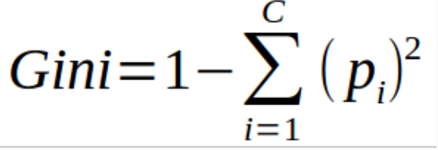
GINI INDEX
The Gini Index is calculated by subtracting the sum of the squared probabilities of each class from one. It favors larger partitions.
Information Gain multiplies the probability of the class times the log (base=2) of that class probability. Information Gain favors smaller partitions with many distinct values. Ultimately, you have to experiment with your data and the splitting criterion.
Algo / Split Criterion | Description | Tree Type
Gini Split / Gini Index | Favors larger partitions. Very simple to implement. | CART
Information Gain / Entropy | Favors partitions that have small counts but many distinct values. | ID3 / C4.5
Favors larger partitions.
Uses squared proportion of classes.
Perfectly classified, Gini Index would be zero.
Evenly distributed would be 1 – (1/# Classes).
You want a variable split that has a low Gini Index.
The algorithm works as 1 – ( P(class1)^2 + P(class2)^2 + … + P(classN)^2)

Slide 10
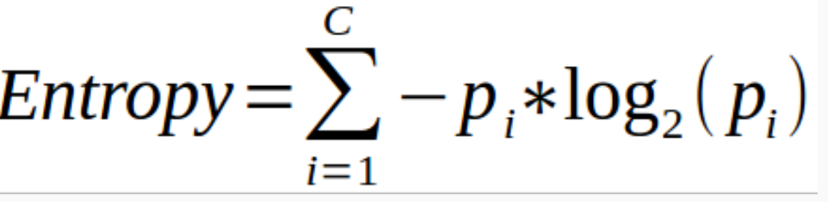
ENTROPY & INFORMATION GAIN
Favors splits with small counts but many unique values.
Weights probability of class by log(base=2) of the class probability
A smaller value of Entropy is better.
That makes the difference between the parent node’s entropy larger.
Information Gain is the Entropy of the parent node minus the entropy of the child nodes.
Entropy is calculated [ P(class1)*log(P(class1),2) + P(class2)*log(P(class2),2) + … + P(classN)*log(P(classN),2)]
When you use Information Gain, which uses Entropy as the base calculation, you have a wider range of results. The Gini Index caps at one.
The maximum value for Entropy depends on the number of classes. It’s based on base-2, so if you have…
Two classes: Max entropy is 1.
Four Classes: Max entropy is 2.
Eight Classes: Max entropy is 3.
16 classes: Max entropy is 4.

Slide 11
Further Attribute Evaluation Measures

Slide 12
Attribute Selection Measure: Information Gain (ID3/C4.5)
Select the attribute with the highest information gain
Let p_{i} be the probability that an arbitrary tuple in D belongs to class C_{i}, estimated by |C_{i, D}|/|D|
Expected information (entropy) needed to classify a tuple in D:
Information needed (after using A to split D into v partitions) to classify D:
Information gained by branching on attribute A
Notes:
I : the expected information needed to classify a given sample
E (entropy) : expected information based on the partitioning into subsets by A

Slide 13
Attribute Selection: Information Gain
Class P: buys_computer = “yes”
Class N: buys_computer = “no”
means “age <=30” has 5 out of 14 samples, with 2 yes’es and 3 no’s. Hence
Similarly,

Slide 14
Gain Ratio for Attribute Selection (C4.5)
Information gain measure is biased towards attributes with a large number of values
C4.5 (a successor of ID3) uses gain ratio to overcome the problem (normalization to information gain)
GainRatio(A) = Gain(A)/SplitInfo(A)
Ex.
gain_ratio(income) = 0.029/1.557 = 0.019
The attribute with the maximum gain ratio is selected as the splitting attribute

Slide 15
Rule-based Classification
Source Courtesy: Some of the contents of this PPT are sourced from materials provided by publishers of prescribed books

Slide 16
Classification Techniques
Decision Tree based Methods
Rule-based Methods
Neural Networks
computational networks that simulate the decision process in neurons (networks of nerve cell)
Naïve Bayes and Bayesian Belief Networks
uses the probability theory to find the most likely of the possible classifications
Support Vector Machines
fits a boundary to a region of points that are all alike; uses the boundary to classify a new point

Slide 17
Rule-Based Classifier
Classify records by using a collection of “if…then…” rules
Rule: (Condition) → y where
Condition is a conjunctions of attributes
y is the class label
LHS: rule antecedent or condition
RHS: rule consequent
Examples of classification rules:
(Blood Type=Warm) ∧ (Lay Eggs=Yes) → Birds
(Taxable Income < 50K) ∧ (Refund=Yes) → Evade=No

Slide 18
Rule-based Classifier (Example)
R1: (Give Birth = no) ∧ (Can Fly = yes) → Birds
R2: (Give Birth = no) ∧ (Live in Water = yes) → Fishes
R3: (Give Birth = yes) ∧ (Blood Type = warm) → Mammals
R4: (Give Birth = no) ∧ (Can Fly = no) → Reptiles
R5: (Live in Water = sometimes) → Amphibians

Slide 19
Application of Rule-Based Classifier
A rule r covers an instance x if the attributes of the instance satisfy the condition of the rule
R1: (Give Birth = no) ∧ (Can Fly = yes) → Birds
R2: (Give Birth = no) ∧ (Live in Water = yes) → Fishes
R3: (Give Birth = yes) ∧ (Blood Type = warm) → Mammals
R4: (Give Birth = no) ∧ (Can Fly = no) → Reptiles
R5: (Live in Water = sometimes) → Amphibians
The rule R1 covers a hawk => Bird
The rule R3 covers the grizzly bear => Mammal

Slide 20
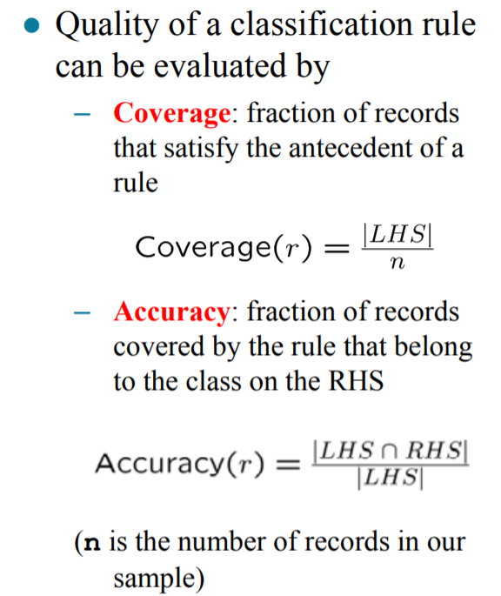
Rule Coverage and Accuracy
(Status=Single) → No
Coverage = 40%, Accuracy = 50%

Slide 21
How does Rule-based Classifier Work?
R1: (Give Birth = no) ∧ (Can Fly = yes) → Birds
R2: (Give Birth = no) ∧ (Live in Water = yes) → Fishes
R3: (Give Birth = yes) ∧ (Blood Type = warm) → Mammals
R4: (Give Birth = no) ∧ (Can Fly = no) → Reptiles
R5: (Live in Water = sometimes) → Amphibians
A lemur triggers rule R3, so it is classified as a mammal
A turtle triggers both R4 and R5
A dogfish shark triggers none of the rules

Slide 22
Characteristics of Rule-Based Classifier
Mutually exclusive rules
Classifier contains mutually exclusive rules if the rules are independent of each other
Every record is covered by at most one rule
Exhaustive rules
Classifier has exhaustive coverage if it accounts for every possible combination of attribute values
Each record is covered by at least one rule

Slide 23
From Decision Trees To Rules
Rules are mutually exclusive and exhaustive
Rule set contains as much information as the tree

Slide 24
Rules Can Be Simplified
Initial Rule: (Refund=No) ∧ (Status=Married) → No
Simplified Rule: (Status=Married) → No

Slide 25
Effect of Rule Simplification
Rules are no longer mutually exclusive
A record may trigger more than one rule
Solution?
Ordered rule set
Unordered rule set – use voting schemes
Rules are no longer exhaustive
A record may not trigger any rules
Solution?
Use a default class

Slide 26
Ordered Rule Set
Rules are rank ordered according to their priority
An ordered rule set is known as a decision list
When a test record is presented to the classifier
It is assigned to the class label of the highest ranked rule it has triggered
If none of the rules fired, it is assigned to the default class
R1: (Give Birth = no) ∧ (Can Fly = yes) → Birds
R2: (Give Birth = no) ∧ (Live in Water = yes) → Fishes
R3: (Give Birth = yes) ∧ (Blood Type = warm) → Mammals
R4: (Give Birth = no) ∧ (Can Fly = no) → Reptiles
R5: (Live in Water = sometimes) → Amphibians

Slide 27
Rule Ordering Schemes
Rule-based ordering
Individual rules are ranked based on their quality
Class-based ordering
Rules that belong to the same class appear together

Slide 28
How to Evaluate Learnt Rule?
Start with the most general rule possible: condition = empty
Adding new attributes by adopting a greedy depth-first strategy
Picks the one that most improves the rule quality
Rule-Quality measures: consider both coverage and accuracy
Foil-gain (in FOIL & RIPPER): assesses info_gain by extending condition
favors rules that have high accuracy and cover many positive tuples
Rule pruning based on an independent set of test tuples
Pos/neg are # of positive/negative tuples covered by R.
If FOIL_Prune is higher for the pruned version of R, prune R

Slide 29
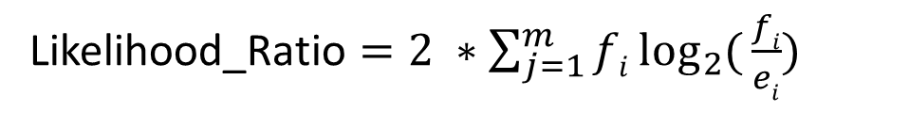
How to Evaluate Learnt Rule?
We can use Likelihood Ratio Statistic, which confirms that effect of rule is not attributed to chance, but represents correlation between attribute value and classes.
m is the number of classes
For tuples satisfying the rule, fi is the observed frequency of each class among tuples, ei is the expected frequency if the rule made random predictions
Higher the Likelihood Ratio, better the rule is.
Likelihood_Ratio $=2 ∗\sum_{j=1}^{m}{fi\log_{2}{(}\frac{fi}{ei})}$

Slide 30
Building Classification Rules
Direct Method:
Extract rules directly from data
e.g.: RIPPER, CN2, Holte’s 1R
Indirect Method:
Extract rules from other classification models (e.g. decision trees, neural networks, etc).
e.g: C4.5rules

Slide 31
Direct Method: Sequential Covering
Start from an empty rule
Grow a rule using the Learn-One-Rule function
Remove training records covered by the rule
Repeat Step (2) and (3) until stopping criterion is met

Slide 32
Indirect Methods

Slide 33
Ensemble Methods
Construct a set of classifiers from the training data
Predict class label of previously unseen records by aggregating predictions made by multiple classifiers

Slide 34
General Idea

Slide 35
Why does it work?
Suppose there are 25 base classifiers
Each classifier has error rate, ε = 0.35
Assume classifiers are independent
Probability that the ensemble classifier makes a wrong prediction:

Slide 36
Prediction
Source Courtesy: Some of the contents of this PPT are sourced from materials provided by publishers of prescribed books

Slide 37
Prediction vs. Classification
How is (Numerical) prediction similar to classification?
construct a model
use model to predict continuous or ordered value for a given input
Difference between Prediction and classification
Classification refers to predict categorical class label
Prediction models continuous-valued functions
Major method for prediction: regression
model the relationship between one or more independent or predictor variables and a dependent or response variable
Profit, sales, mortgage rates, house values, square footage, temperature, or distance could all be predicted using regression techniques. For example, a regression model could be used to predict the value of a house based on location, number of rooms, lot size, and other factors.

Slide 38
Regression for Prediction
A regression task begins with a data set in which the target values are known, e.g., a regression model that predicts house values could be developed based on observed data for many houses over a period of time. The data might track the age of the house, square footage, number of rooms, taxes, school district, proximity to shopping centers, and so on. House value would be the target, the other attributes would be the predictors, and the data for each house would constitute a case.
In the model build (training) process, a regression algorithm estimates the value of the target as a function of the predictors for each case in the build data. These relationships between predictors and target are summarized in a model, which can then be applied to a different data set in which the target values are unknown

Slide 39
Prediction Techniques
Regression analysis
Linear and multiple regression
Non-linear regression
Other regression methods: generalized linear model, Poisson regression, log-linear models, regression trees

Slide 40
Regression analysis
Regression analysis seeks to determine the values of parameters for a function that cause the function to best fit a set of data observations that you provide.
The following equation expresses these relationships in symbols. It shows that regression is the process of estimating the value of a continuous target (y) as a function (F) of one or more predictors (x1 , x2 , ..., xn), a set of parameters (w1 , w2 , ..., wn), and a measure of error (e).
y = F(x,w) + e
The predictors can be understood as independent variables and the target as a dependent variable. The error, also called the residual, is the difference between the expected and predicted value of the dependent variable. The regression parameters are also known as regression coefficients.
The process of training a regression model involves finding the parameter values that minimize a measure of the error, for example, the sum of squared errors.

Slide 41
Linear Regression
Linear regression: involves a response variable y and a single predictor variable x
y = w₀ + w₁ x
where w₀ (y-intercept) and w₁ (slope) are regression coefficients
Method of least squares: estimates the best-fitting straight line
Multiple linear regression: involves more than one predictor variable
Training data is of the form (X₁, y₁), (X₂, y₂),…, (X_{|D|}, y_{|D|})
Ex. For 2-D data, we may have: y = w₀ + w₁ x₁+ w₂ x₂
Solvable by extension of least square method or using SAS, S-Plus
Many nonlinear functions can be transformed into the above

Slide 42
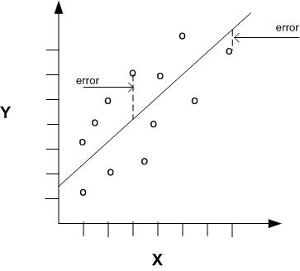
Linear Regression With a Single Predictor

Slide 43
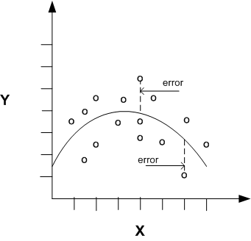
Nonlinear Regression
Often the relationship between x and y cannot be approximated with a straight line. In this case, a nonlinear regression technique may be used. Alternatively, the data could be preprocessed to make the relationship linear.
Nonlinear regression models define y as a function of x using an equation that is more complicated than the linear regression equation

Slide 44
Nonlinear Regression
Some nonlinear models can be modeled by a polynomial function
A polynomial regression model can be transformed into linear regression model. For example,
y = w0 + w1 x + w2 x2 + w3 x3
convertible to linear with new variables: x2 = x2, x3= x3
y = w0 + w1 x + w2 x2 + w3 x3
Other functions, such as power function, can also be transformed to linear model
Some models are intractable nonlinear (e.g., sum of exponential terms)
possible to obtain least square estimates through extensive calculation on more complex formulae

Slide 45
Regression Trees and Model Trees
Regression tree: proposed in CART system (Breiman et al. 1984)
CART: Classification And Regression Trees
Each leaf stores a continuous-valued prediction
It is the average value of the predicted attribute for the training tuples that reach the leaf
Model tree: proposed by Quinlan (1992)
Each leaf holds a regression model—a multivariate linear equation for the predicted attribute
A more general case than regression tree
Regression and model trees tend to be more accurate than linear regression when the data are not represented well by a simple linear model

Slide 46
Prescribed Text Books
 | Author(s), Title, Edition, Publishing House
T1 | Tan P. N., Steinbach M & Kumar V. “Introduction to Data Mining” Pearson Education
T2 | Data Mining: Concepts and Techniques, Third Edition by Jiawei Han, Micheline Kamber and Jian Pei Morgan Kaufmann Publishers

Slide 47
Thank You

